Slide 1


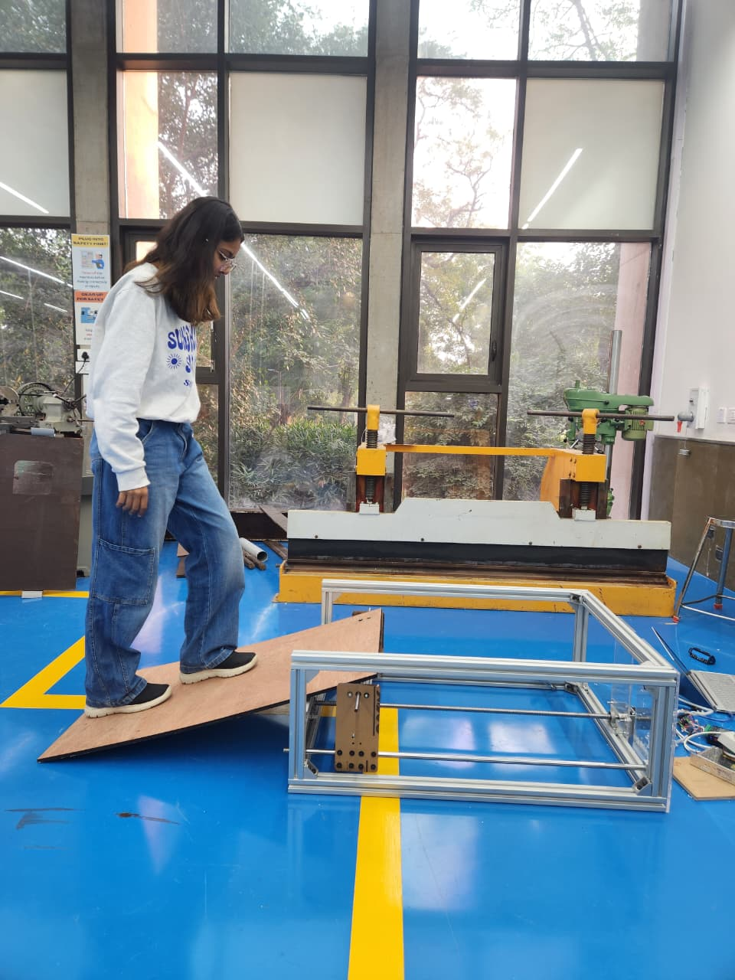
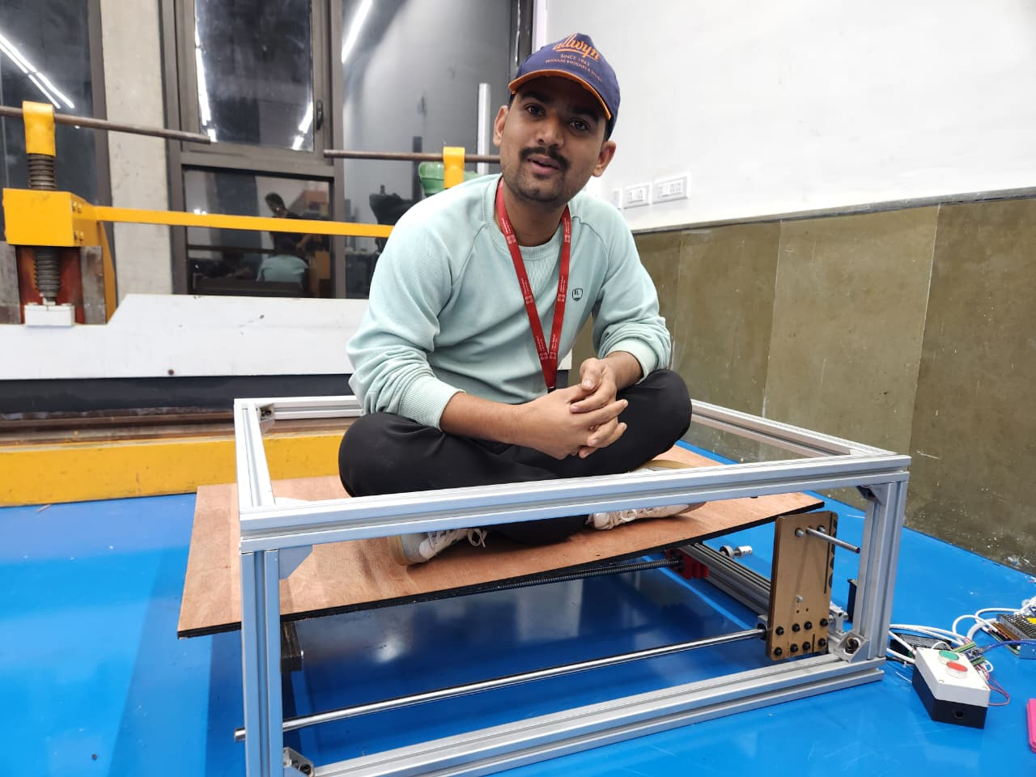
Bridging the Gap: Automatic Boarding Ramp for Safer Public Transport
ENR215
TEAM No.
25
DESIGN, INNOVATION AND MAKING
MONSOON 2025-2026
TEAM MEMBERS
MOTIVATION
Millions of passengers struggle every day while boarding and deboarding trains because of the vertical (300–500 mm) and horizontal (200–450 mm) gaps between the platform and coach. This gap puts elderly people, children, pregnant women and passengers with disabilities at real risk of slipping or falling.
CUSTOMER REQUIREMENTS
Safe, stable bridge for boarding
Automatic Deployment
Low maintenance and reliable
Compact And Durable
Works in various station conditions
Comfortable Slope Angle For All Users
BENEFICIARIES
PRODUCT SPECIFICATION
Mechanism: Lead screw linear actuator (16mm)
Max Load: - 150-400Kg (Depends Material Used)
Power: - 12-24V Dc
Deployment Time: - 5-30Sec (Subject To Motor Speed)
Material: Aluminium composite

Slide 2
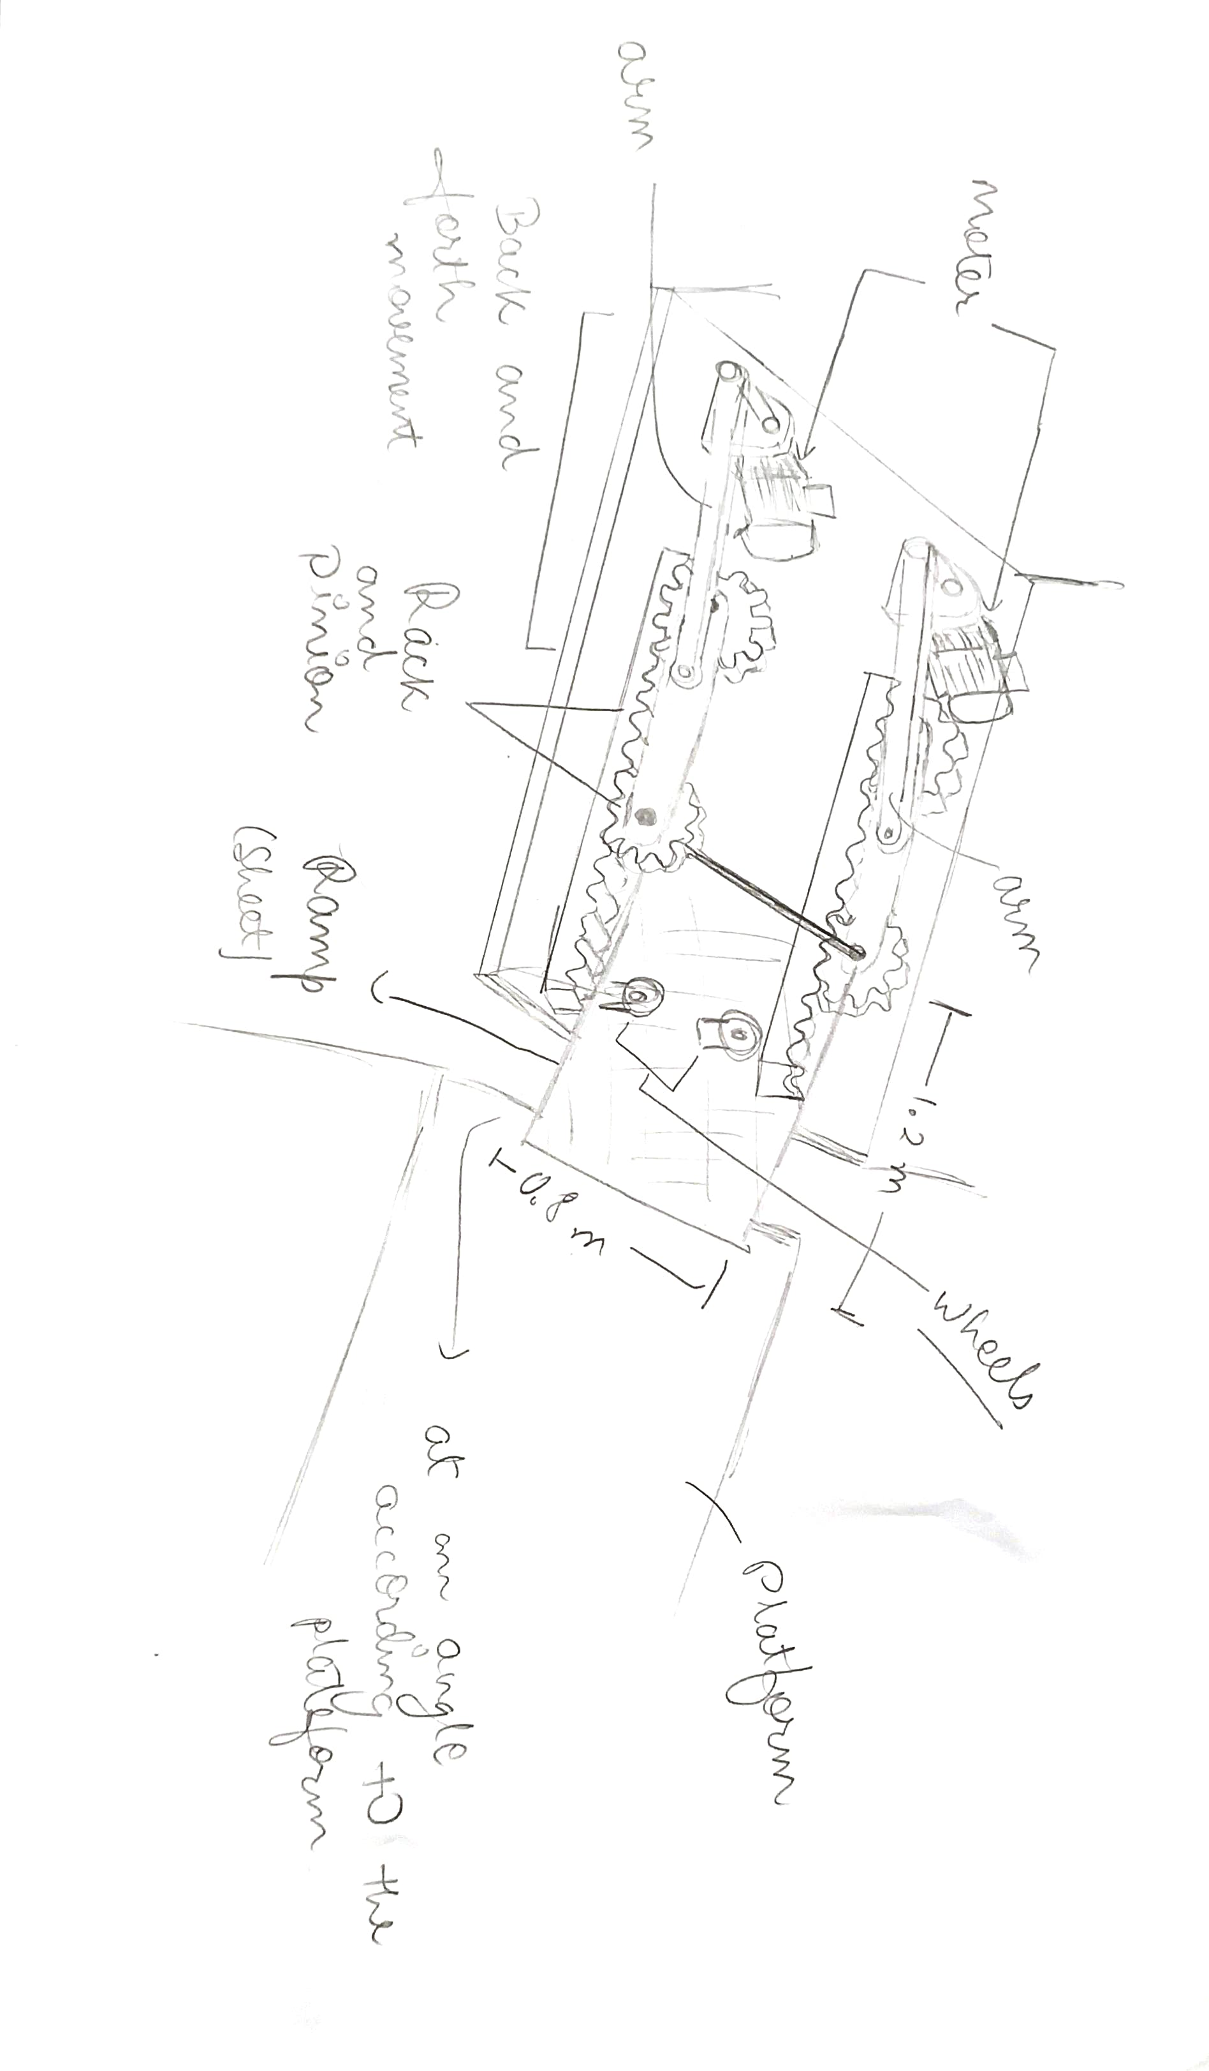
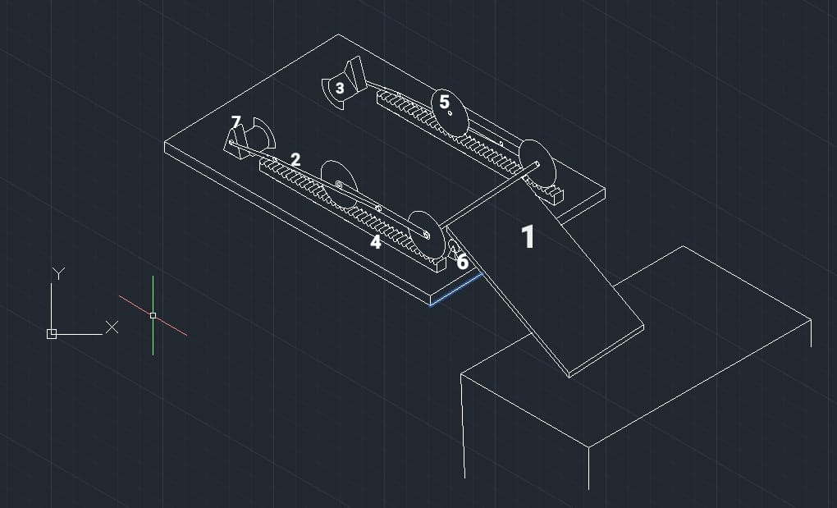
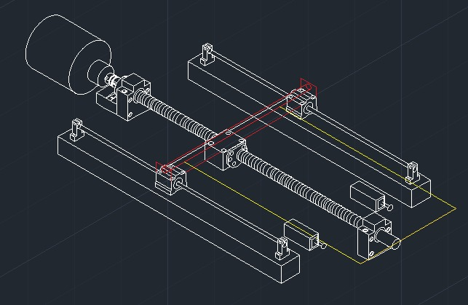
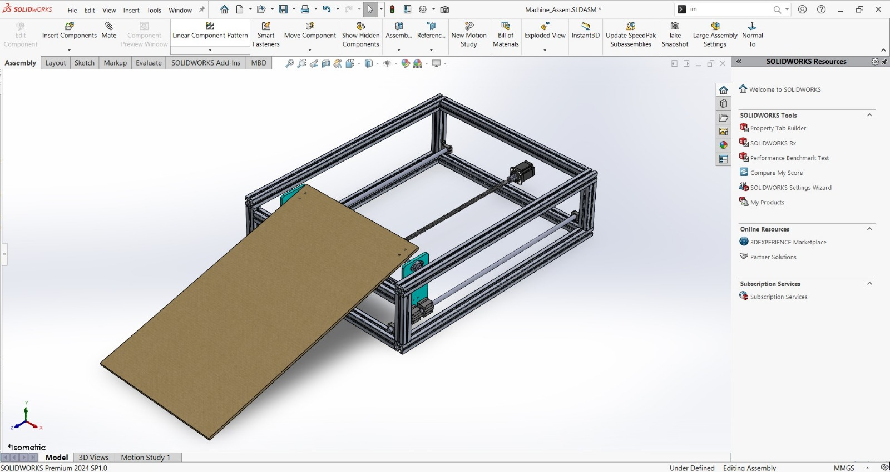
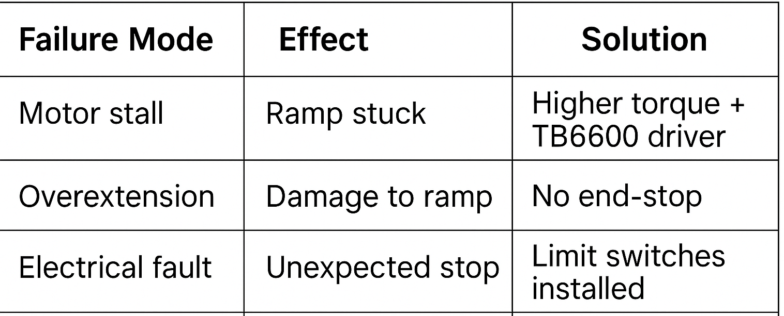
Bridging the Gap: Automatic Boarding Ramp for Safer Public Transport
ENR215
TEAM No.
25
DESIGN, INNOVATION AND MAKING
MONSOON 2025-2026
CONCEPT DESIGNS
DESIGN ALTERNATIVES EVALUATION
1.Hydraulic Lift Ramp
Smooth movement – Expensive, high maintenance
2. Chain and Belt Mechanism
Not ideal for precise and controlled motion.
3. Pneumatic cylinder mechanism
Expensive, high maintenance
4. Lead Screw Mechanism (Chosen*)
High stability, Precise motion, Low maintenance and Best value-for-cost.
Sketch of Concept-3
Sketch of Concept-4
CES, MATERIALS SELECTION
High Strength to weight ratio
Low cost and high availability
Safe for repeated loading
Good corrosion resistance
Aluminum Makes it ideal for ramp. (plywood for Demo)
FMEA, TRIZ IMPROVEMENTS
Principle 2: Taking Out : Removes the need for manual assistance
Principle 15: Dynamics : Adjustable extension based on platform gap
Principle 24: Intermediary : Motor + leadscrew converts rotation to linear motion
POKA YOKE ANALYSIS
Basic error-proofing steps were considered such as avoiding motor overload, preventing over-extension using limit switches, ensuring proper wiring to avoid sudden stops, and reducing chances of ramp collision. These measures help minimize common user mistakes and improve the overall safety of the ramp.

Slide 3
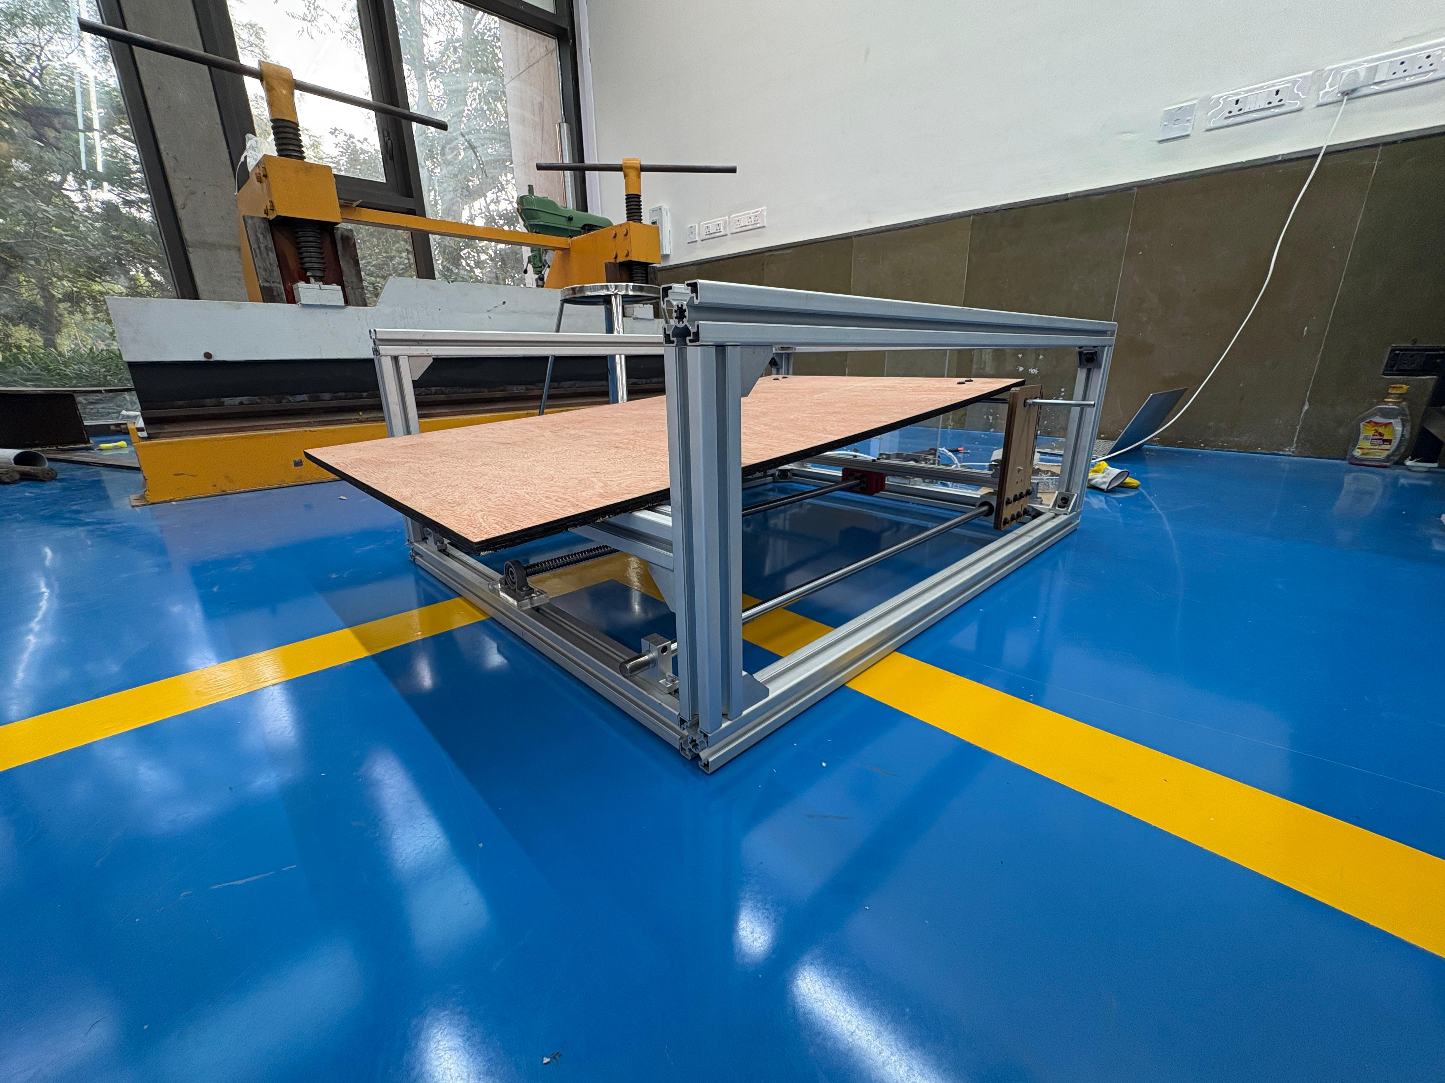
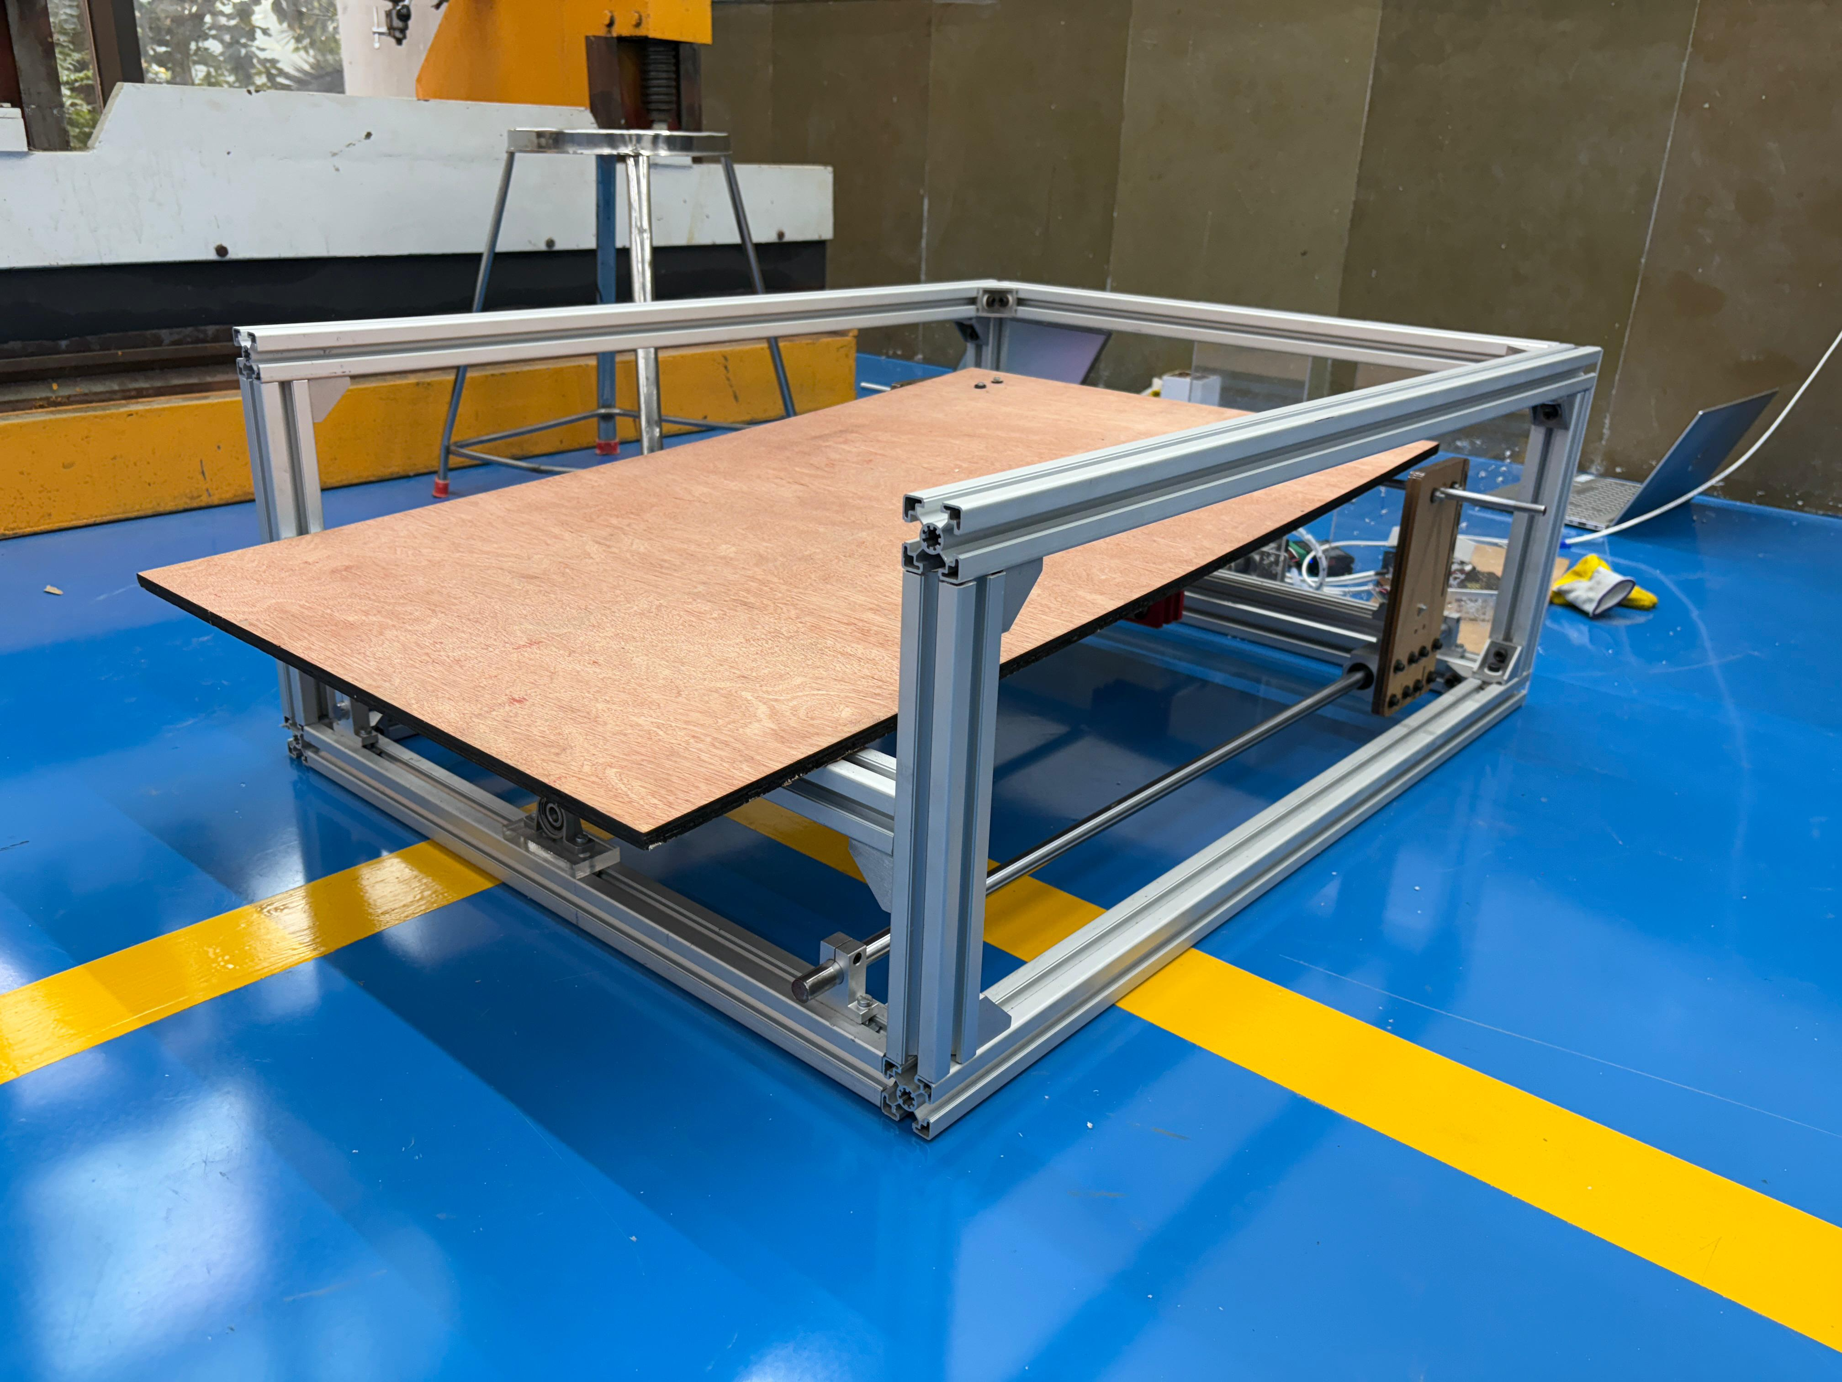
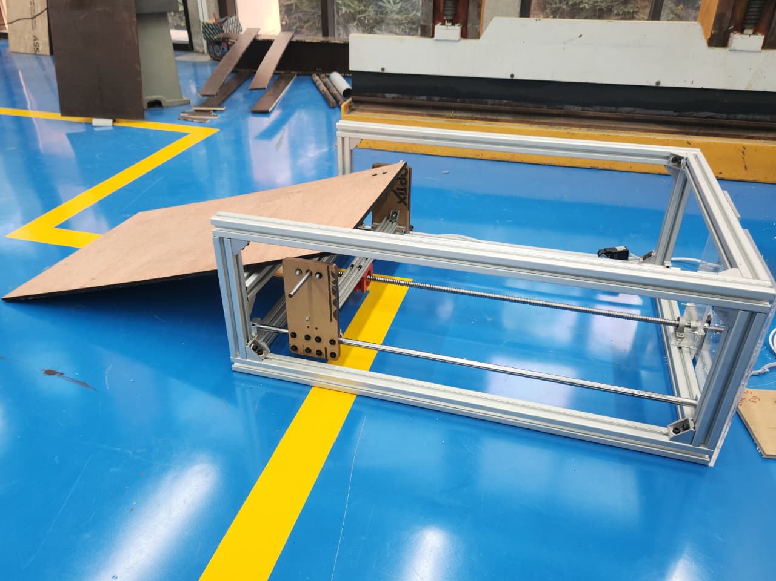
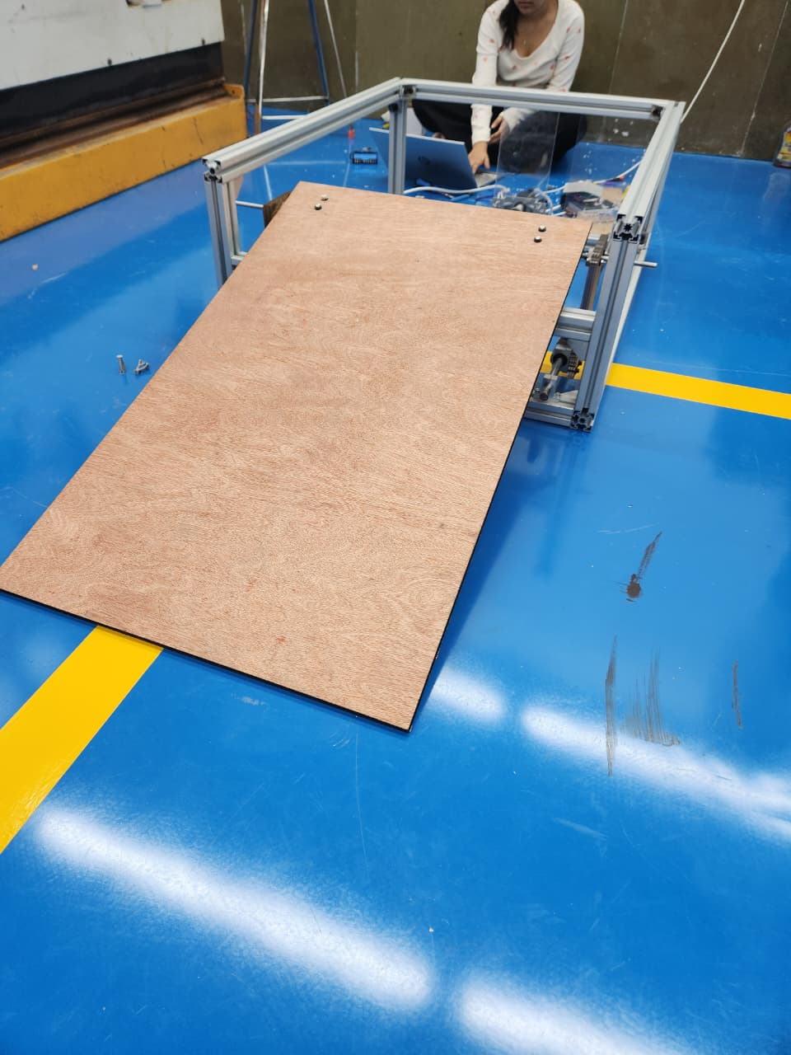
Bridging the Gap: Automatic Boarding Ramp for Safer Public Transport
ENR215
TEAM No.
25
DESIGN, INNOVATION AND MAKING
MONSOON 2025-2026
FINISHED PRODUCT
PERFORMANCE TEST RESULTS
Deployment: - 33.05 Sec
Load: - 90-130 Kg
Structure remained stable with no bending or deformation during testing.
Limit switches successfully stopped the ramp at the correct positions.
CHALLENGES FACED
Group Meet-ups And Coordination.
Designing The Model (3D Design).
Selecting a Perfect Mechanism.
Integrating mechanics and electronics.
Adjusting Motor Speed And Load.
Program bugs in limit-switch logic.
END USER FEEDBACK
Students: - Simple and reliable design
Elderly testers: -Much easier and safer to board.
NEW LEARNINGS FROM THE COURSE
Real-world problem-solving.
Improved skills in prototyping and made System From Scratch.
Understood how to compare mechanisms and select the best one using design reasoning.

